Slide 1
Portfolio Slide Deck

Slide 2
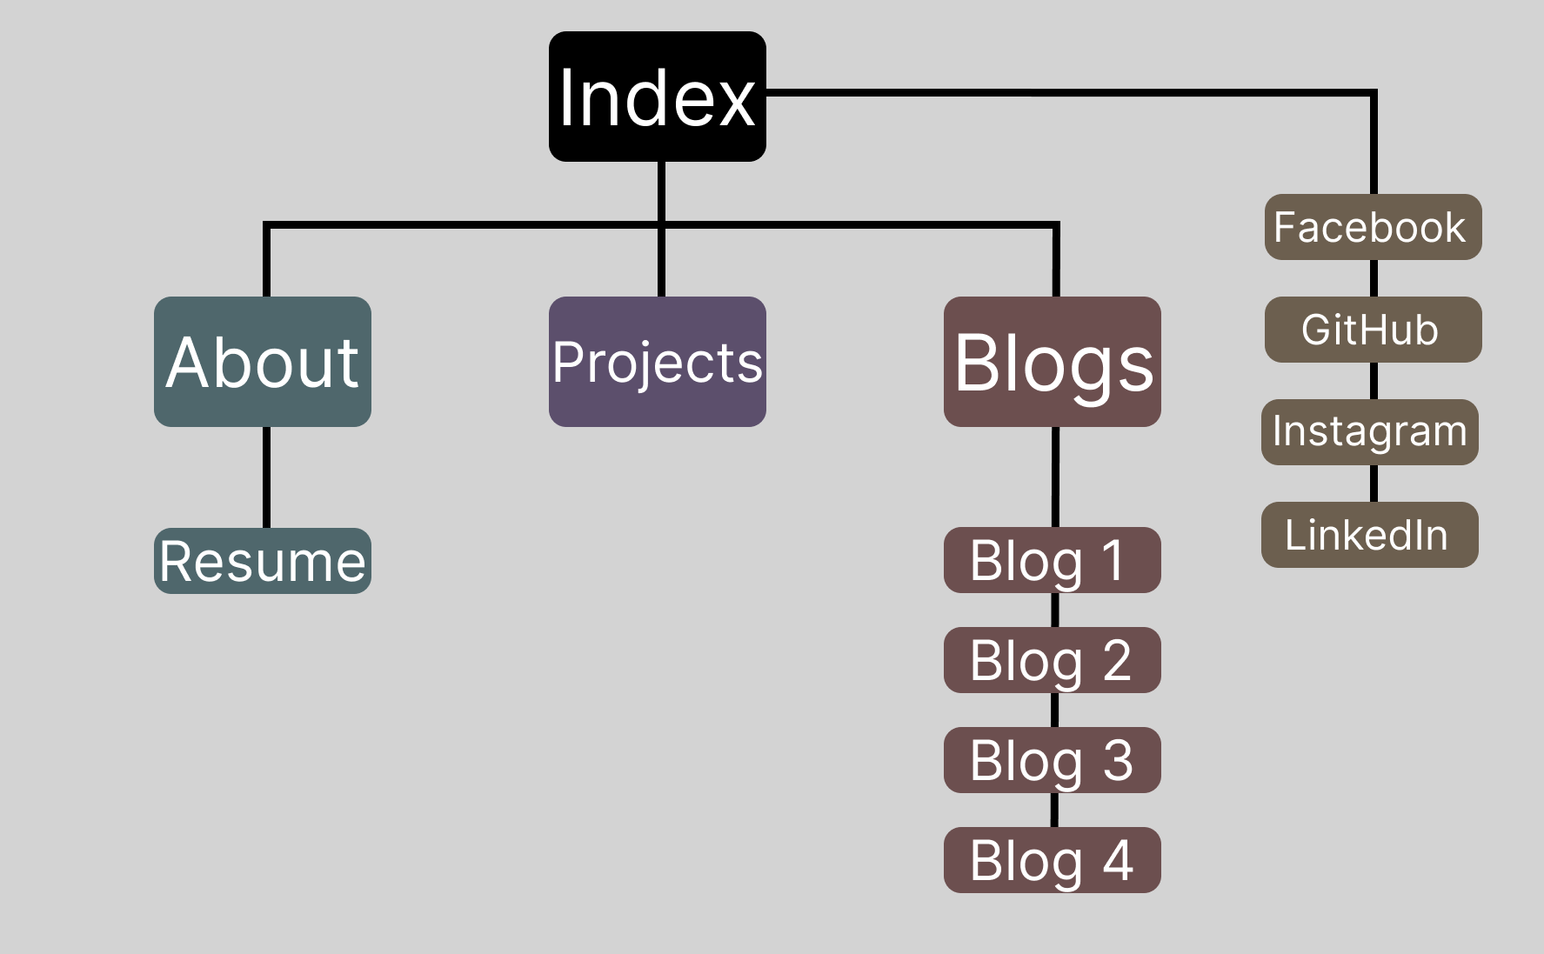
Sitemap

Slide 3
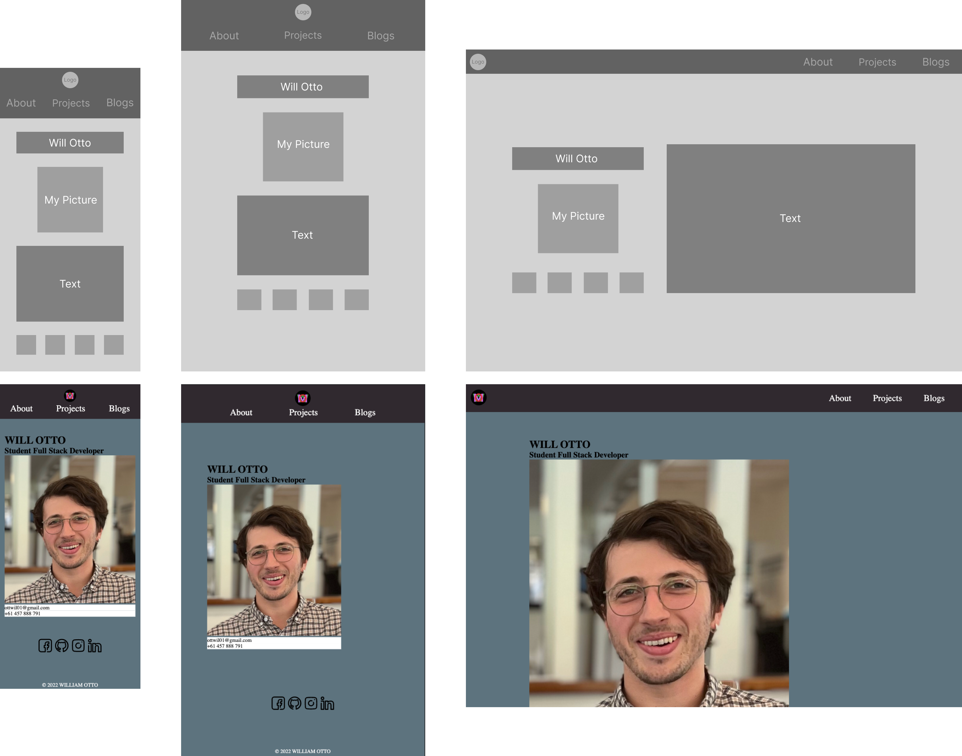
Index Page Wireframes

Slide 4
Index Page

Slide 5
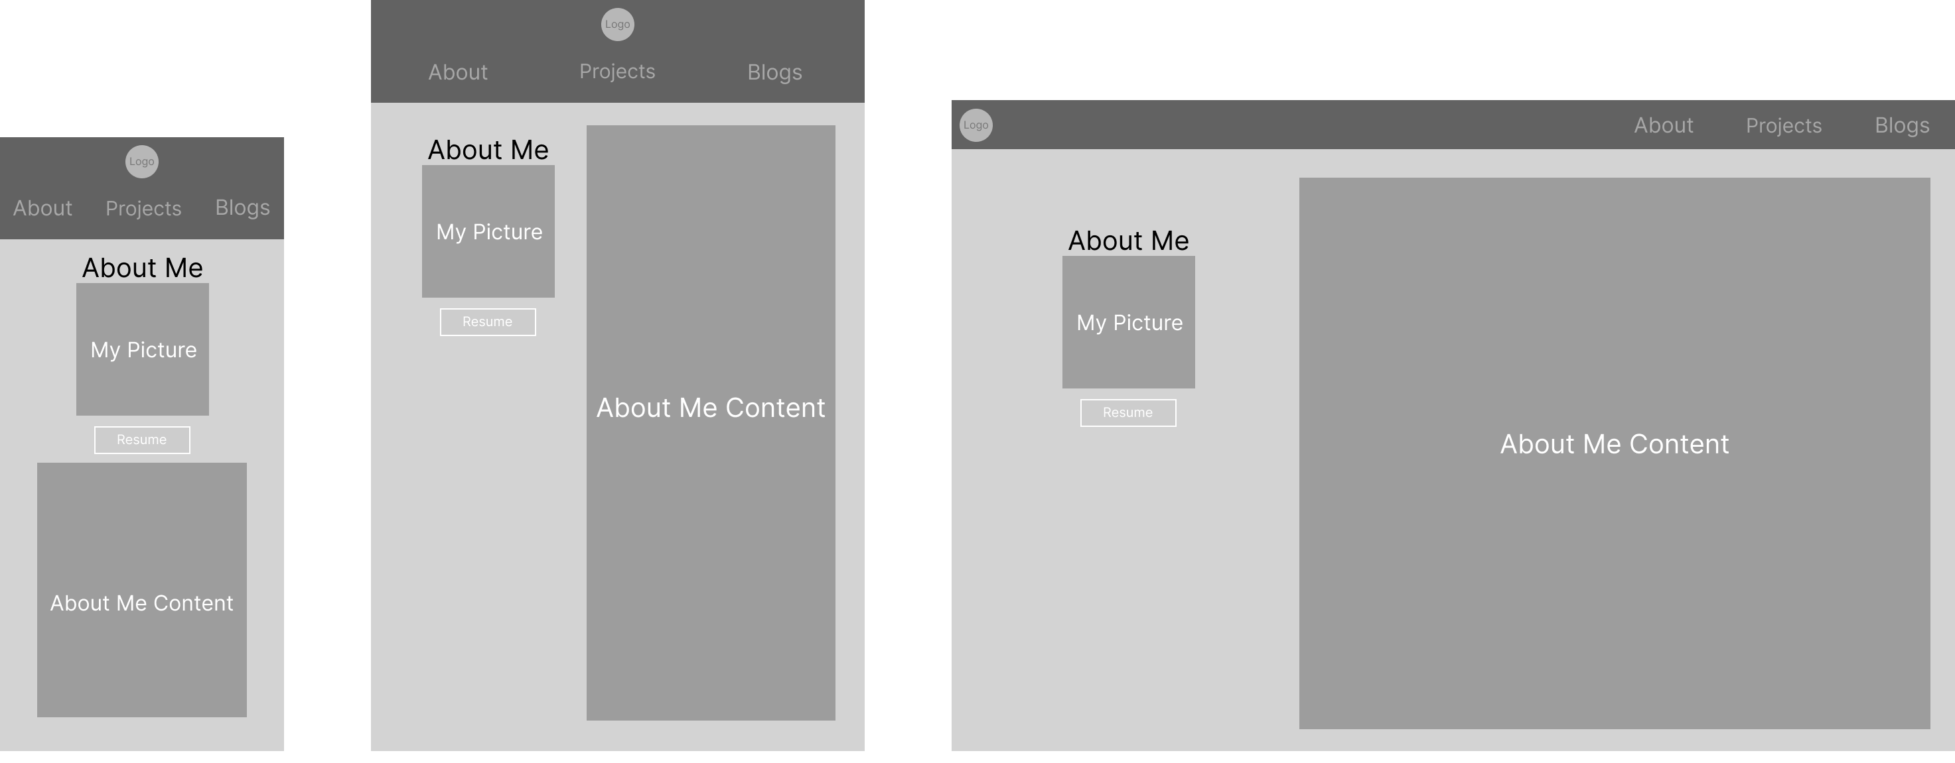
About Page Wireframes

Slide 6
About Page

Slide 7
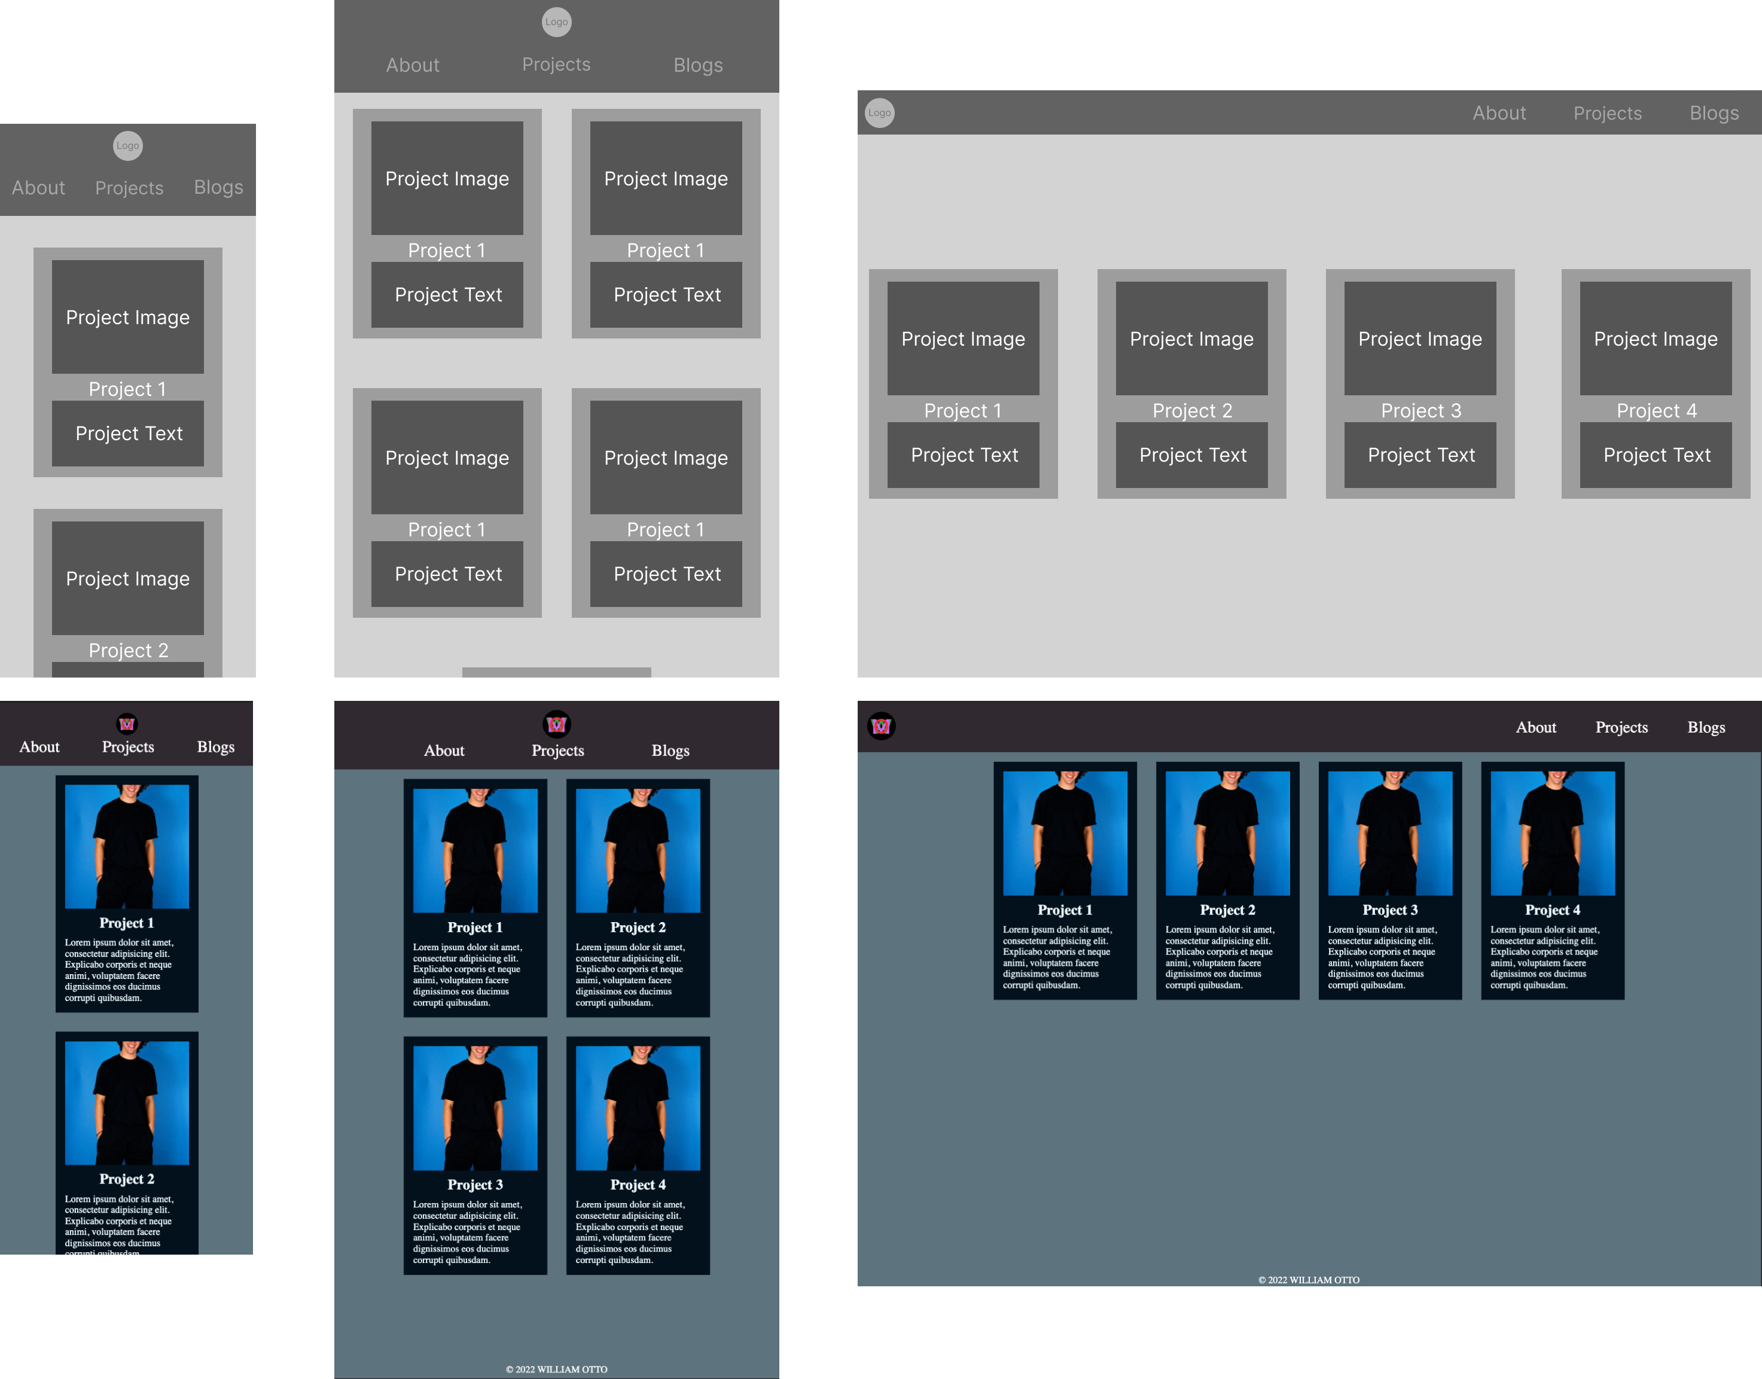
Projects Page Wireframes

Slide 8
Projects Page

Slide 9
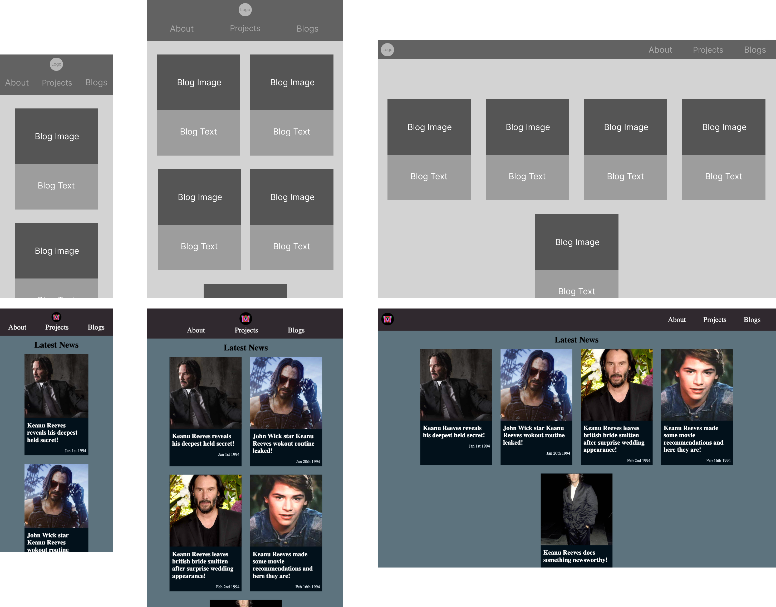
Blog Pages Wireframes

Slide 10
Blogs Pages

Slide 11
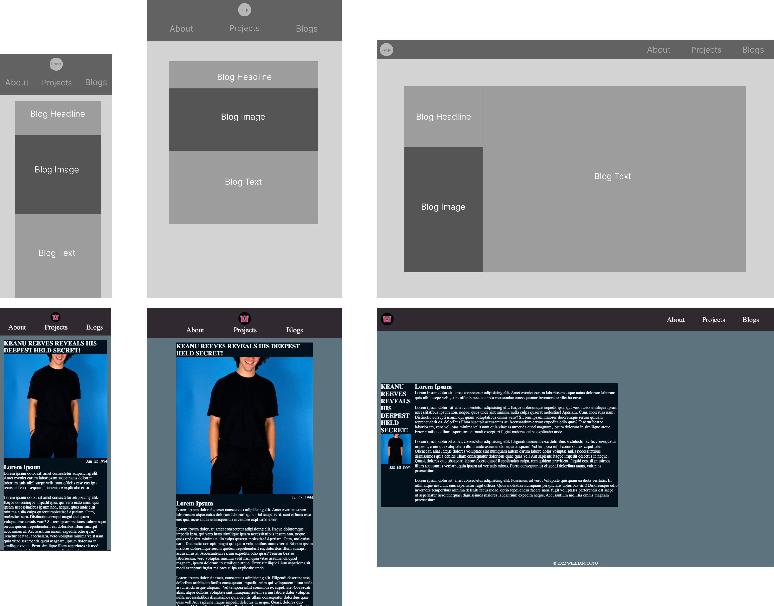
Blogs Pages Example Wireframe

Slide 12
Blogs Pages Example

